Slide 1
Fracture Measurement in CT
Omar Alamoudi and Logan Schmidt

Slide 2
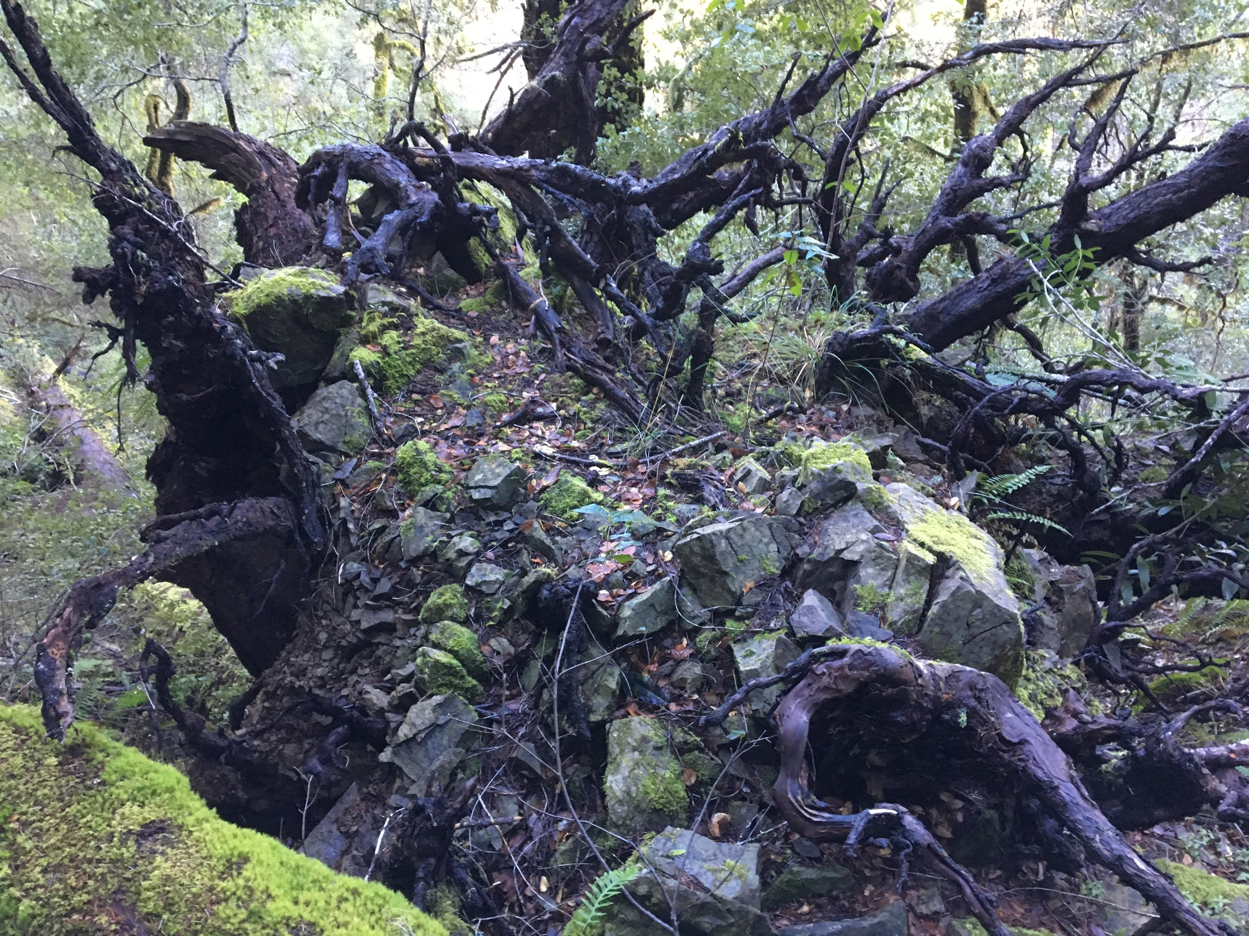
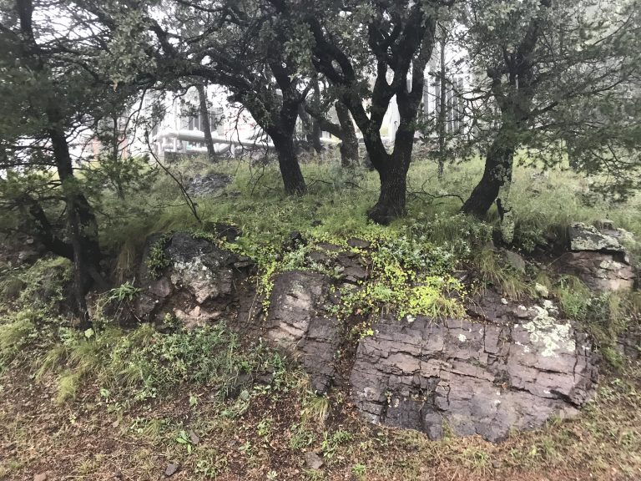
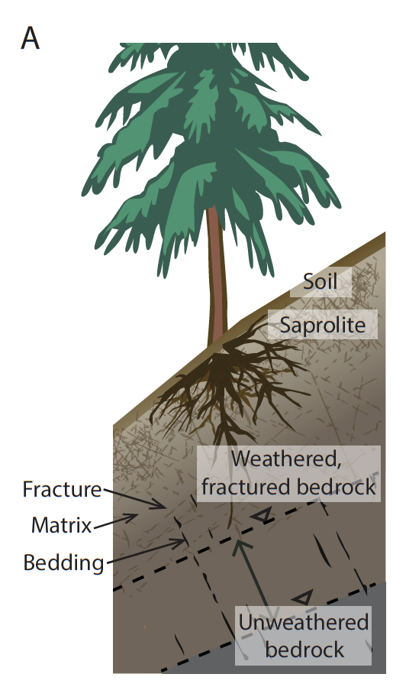
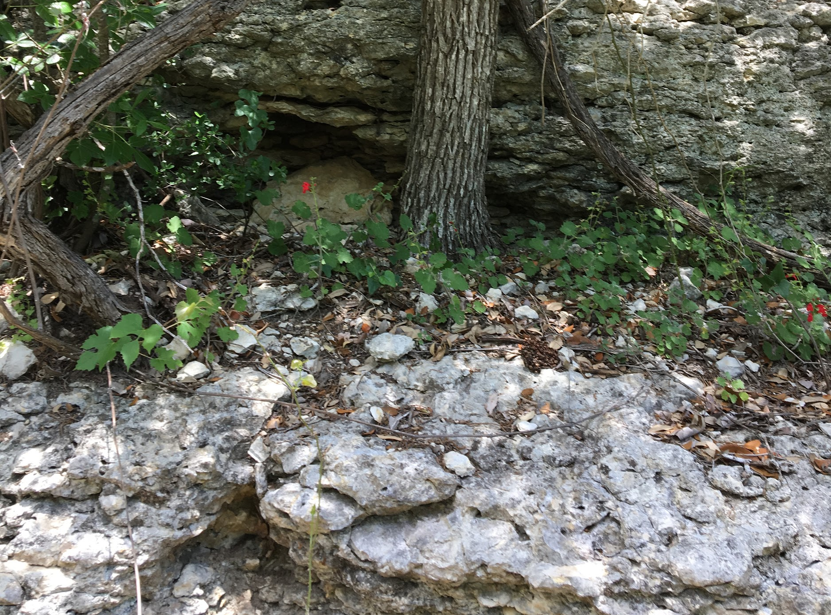
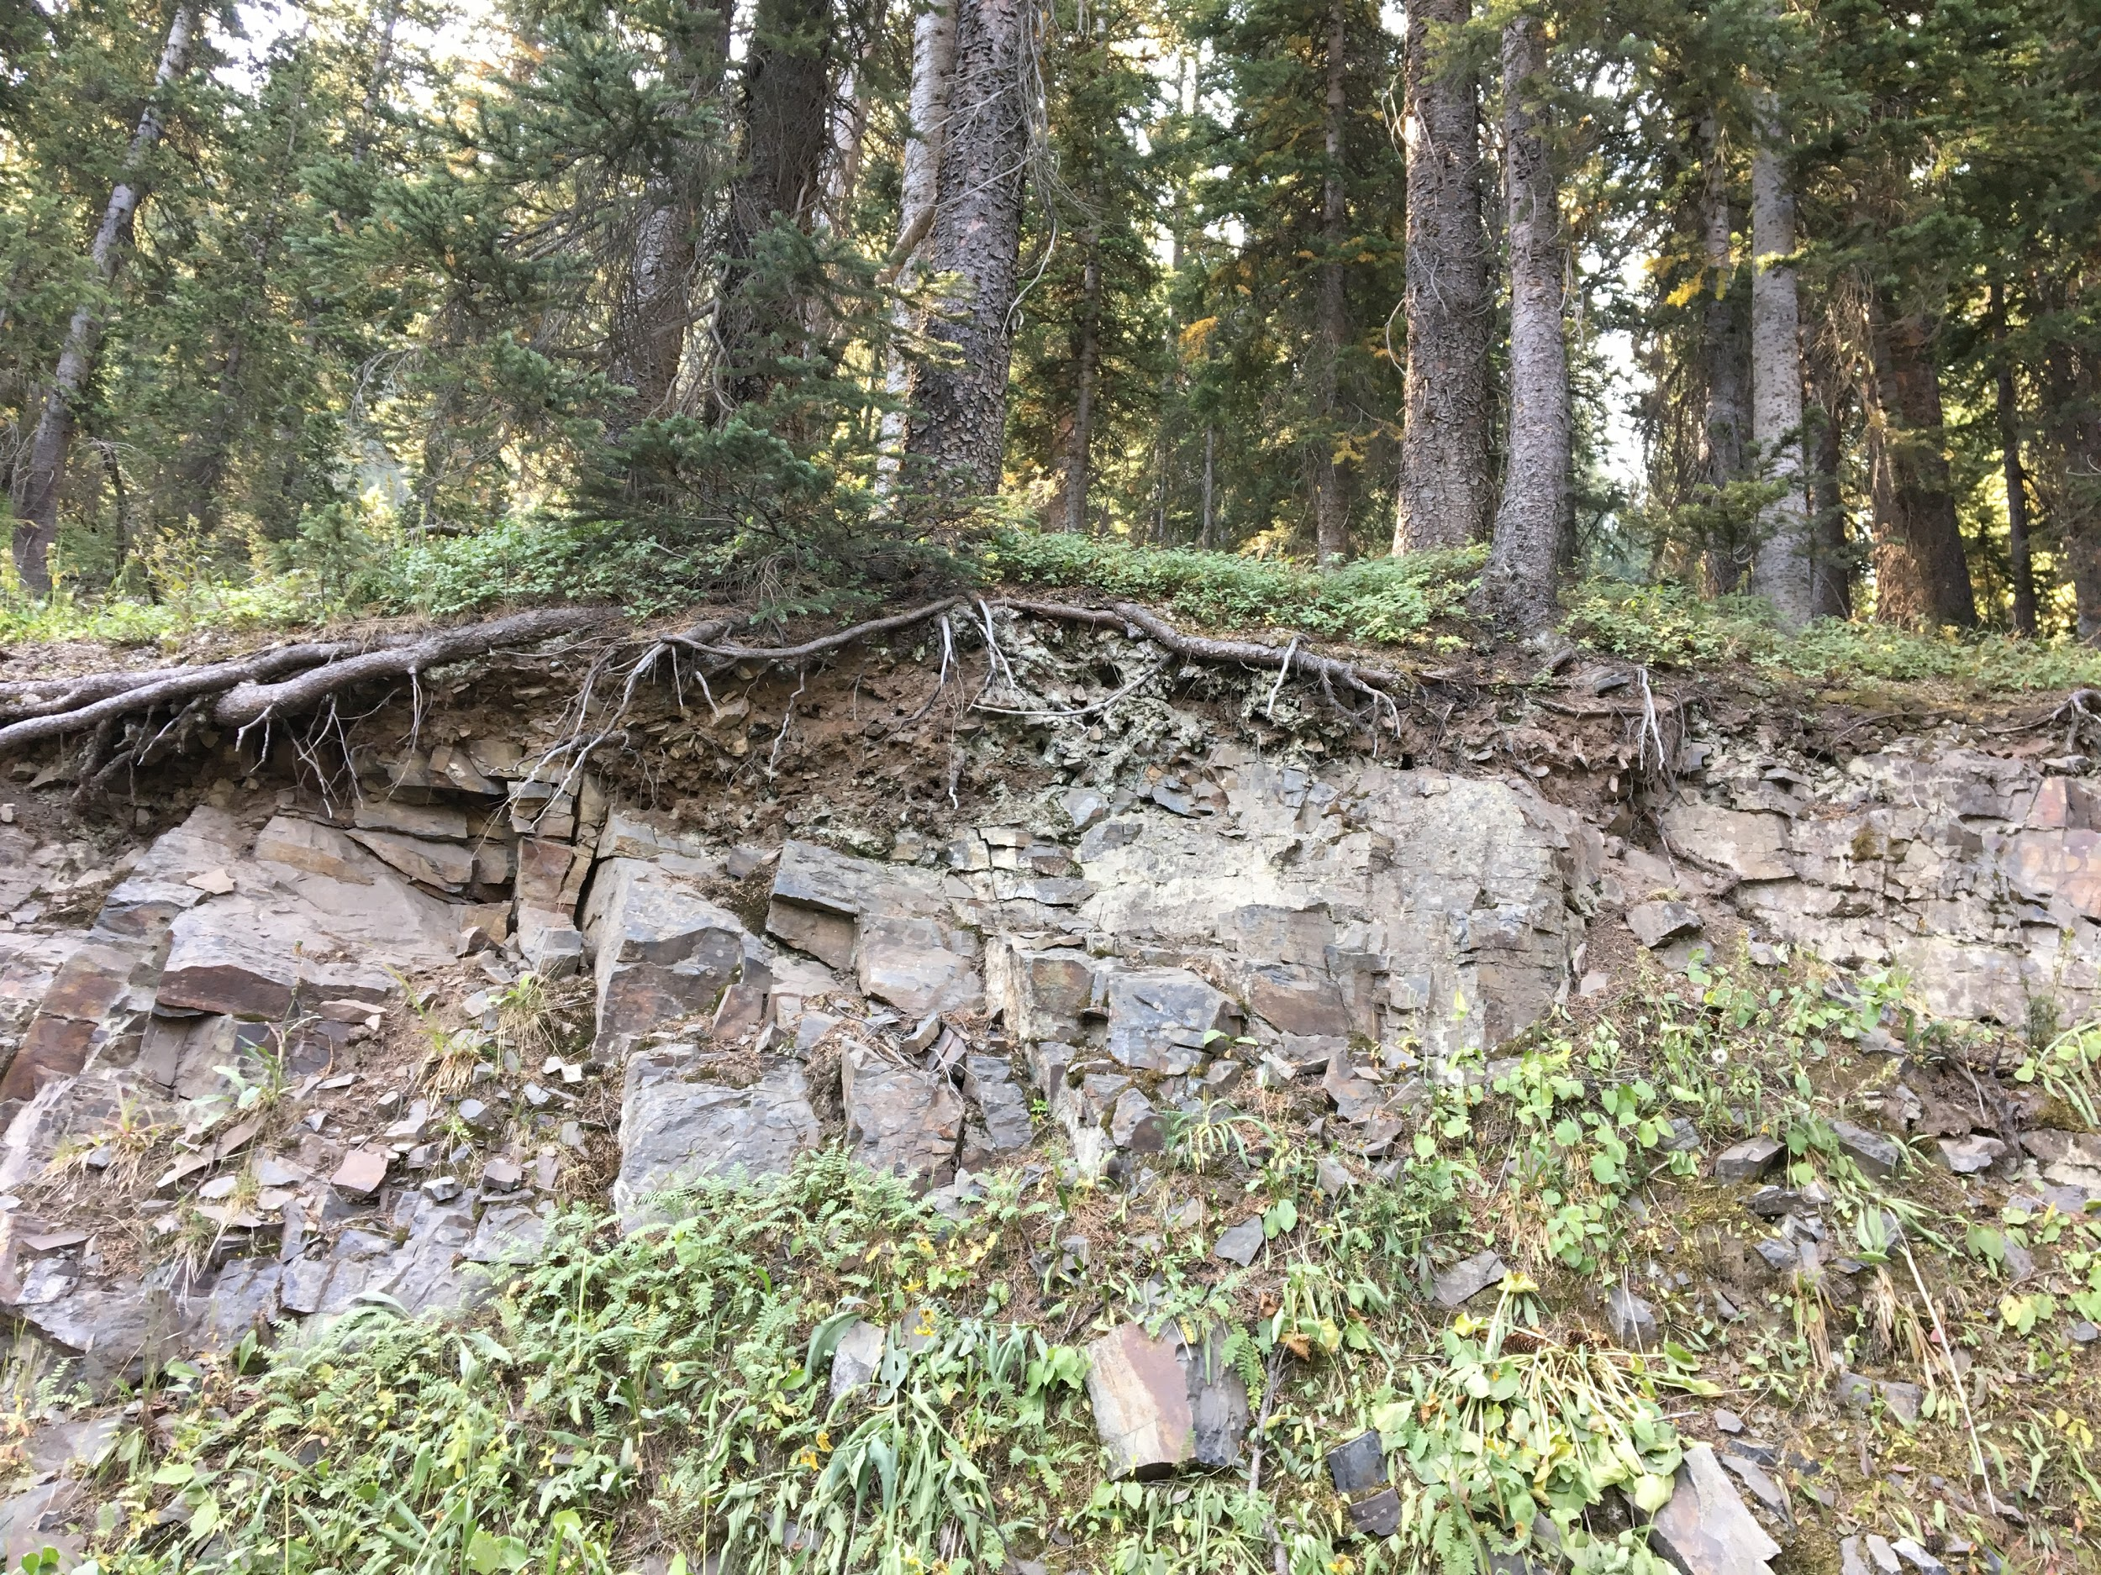
Motivation: Water storage in unsaturated fractured bedrock is important
Eel River, CA Sandstone
McDonald Observatory, TX Volcanics
White Property, TX Karst
Gothic, CO Mudstone

Slide 3
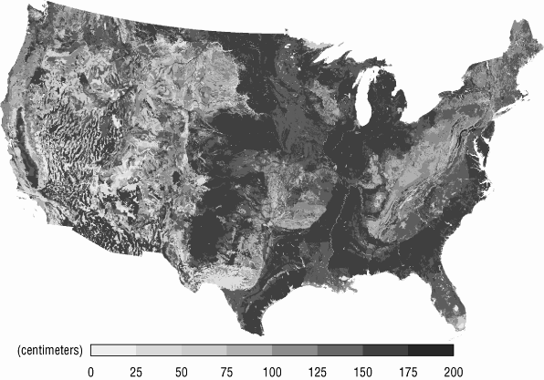
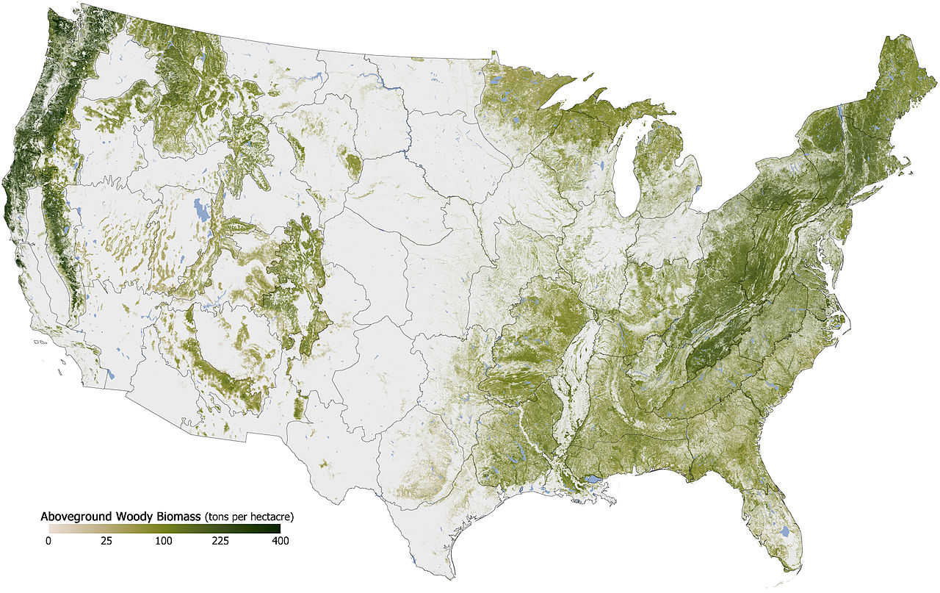
Motivation: Water storage in unsaturated weathered bedrock is important
Depth to bedrock
(NASA Earth Observatory map by Robert Simmon)
(Miller and White, 1998)

Slide 4
Proposed Research Objectives
Eel River, CA Sandstone
McDonald Observatory, TX Volcanics
Depth to bedrock
(Miller and White, 1998)
White Property, TX Karst
Gothic, CO Mudstone

Slide 5
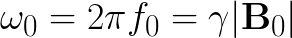
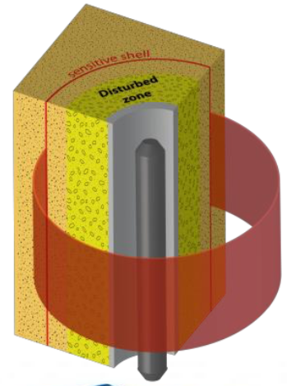
Motivation: NMR is uniquely suited for hydrological investigations in the weathered bedrock vadose zone
Directly sensitive to water
No site-specific calibration
Matrix-independent water content measurement
Fixed, well-defined volume of investigation
High vertical resolution
Decades of use in petroleum exploration
Sensitive to pore environment
(Vista Clara, Inc.)
Notes:
Direct comparison to NP

Slide 6
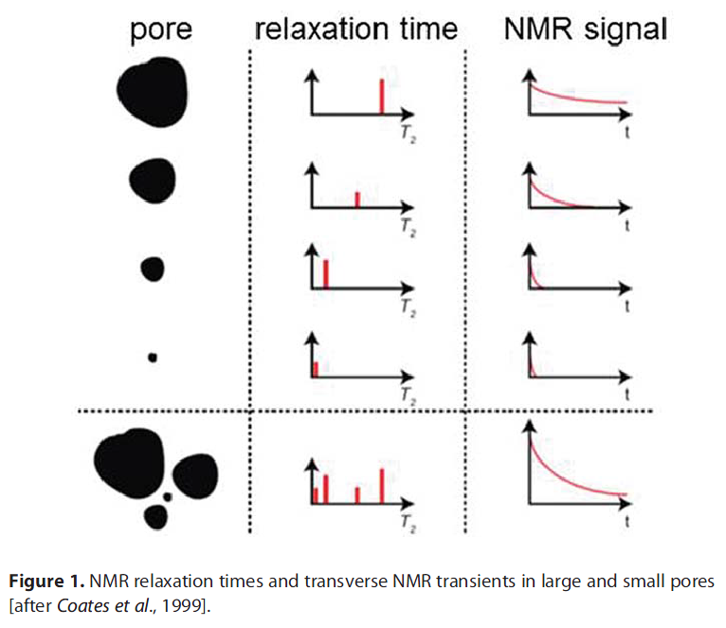
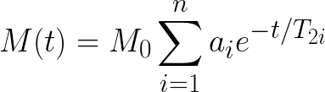
Motivation: NMR is uniquely suited for hydrological investigations in the weathered bedrock vadose zone
Initial amplitude directly proportional to water content
Signal decay (relaxation) influenced by pore environment
(Coates et al., 1999)
Notes:
Link to slides together

Slide 7
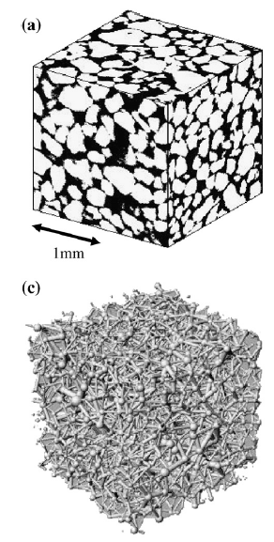
Part 3 Question: What is the water potential of rock moisture
(Talabi et al., 2009)
Notes:
Budget and simplify

Slide 8
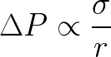
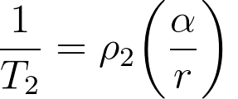
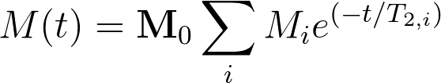
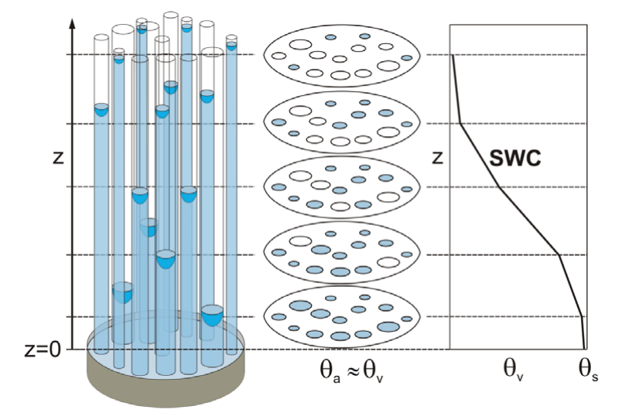
Part 3 Methods: NMR relaxation is controlled by pore radius and can be related to water potential
(Tuller et al., 2005)
(Coates et al., 1999)
Notes:
Emphasize that that this proof of concept model is mine

Slide 9
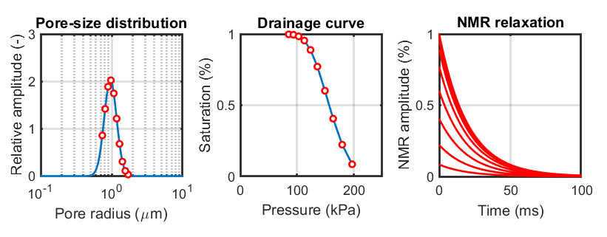
Part 3 Methods: NMR relaxation can be related to water potential
Notes:
Emphasize that that this proof of concept model is mine

Slide 10
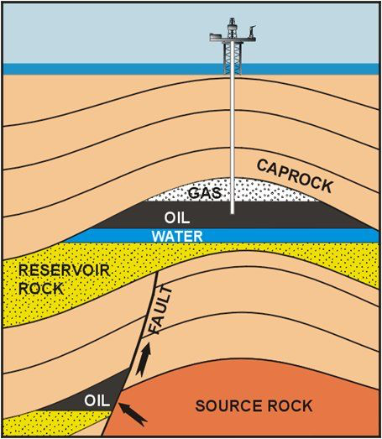
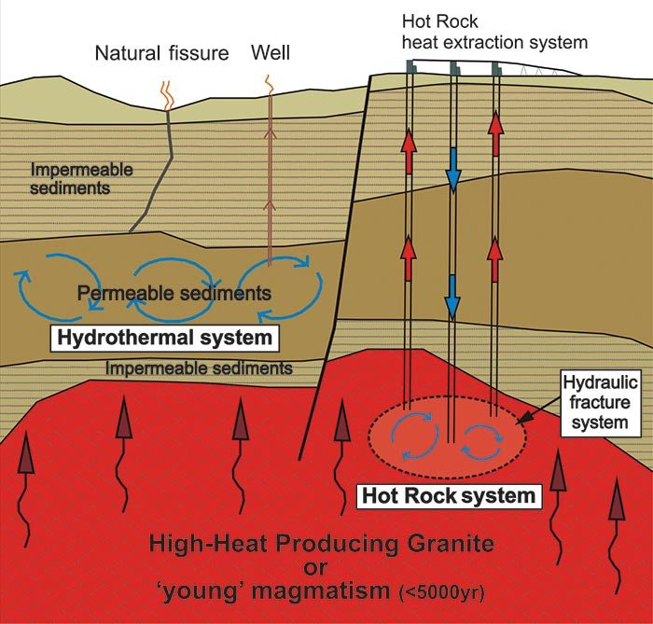
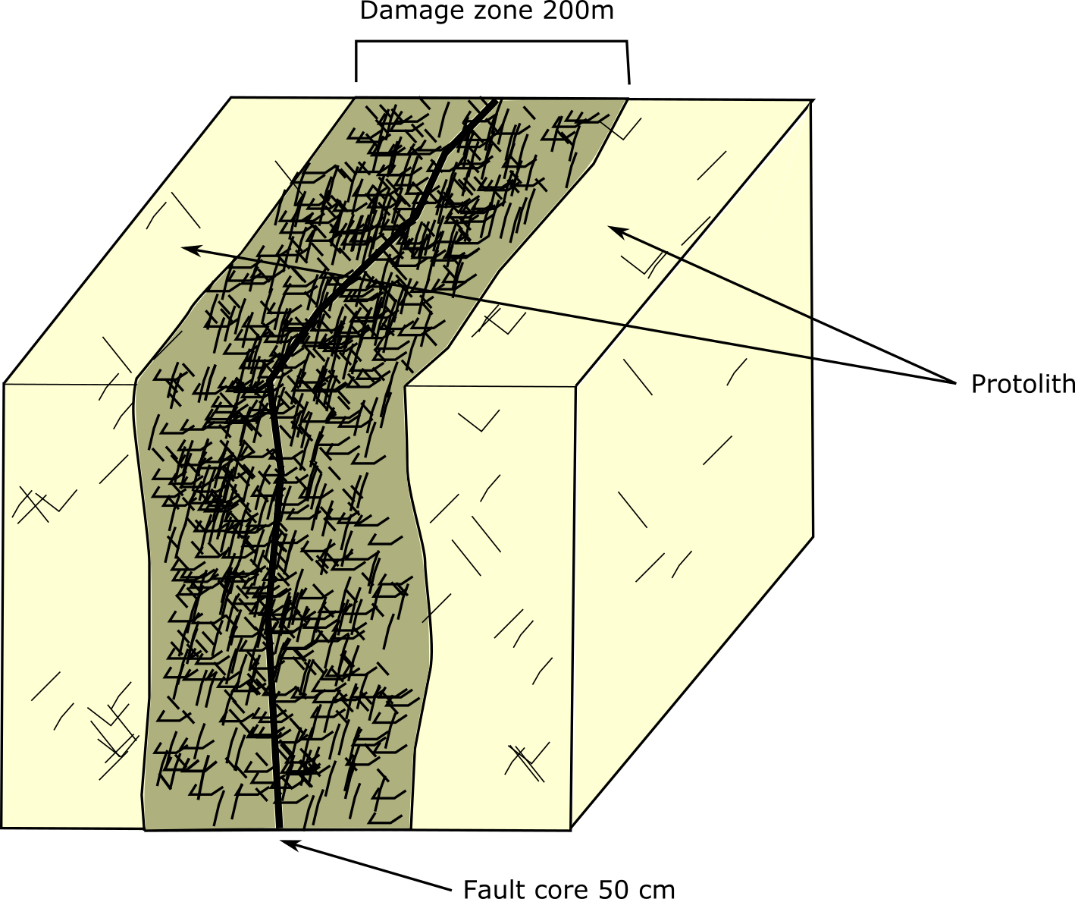
Motivation
https://structuredatabase.wordpress.com/fault-zone-structure-and-permeability/
https://www.science.org.au/curious/technology-future/feeling-heat-geothermal-energy
Notes:
Fractures act as a conduit for fluid flow and they come in multiple scales, and are relavent in many different applications. In faults zones, fractured rocks interact with fluids that could potentially activate their slip, fractures act as pathwasy for hydrocarbon, and other subsurface fluids to migrate.

Slide 11
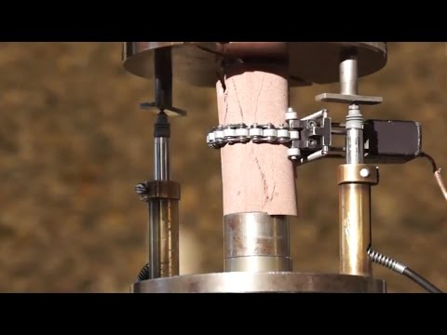
Motivation

Slide 12
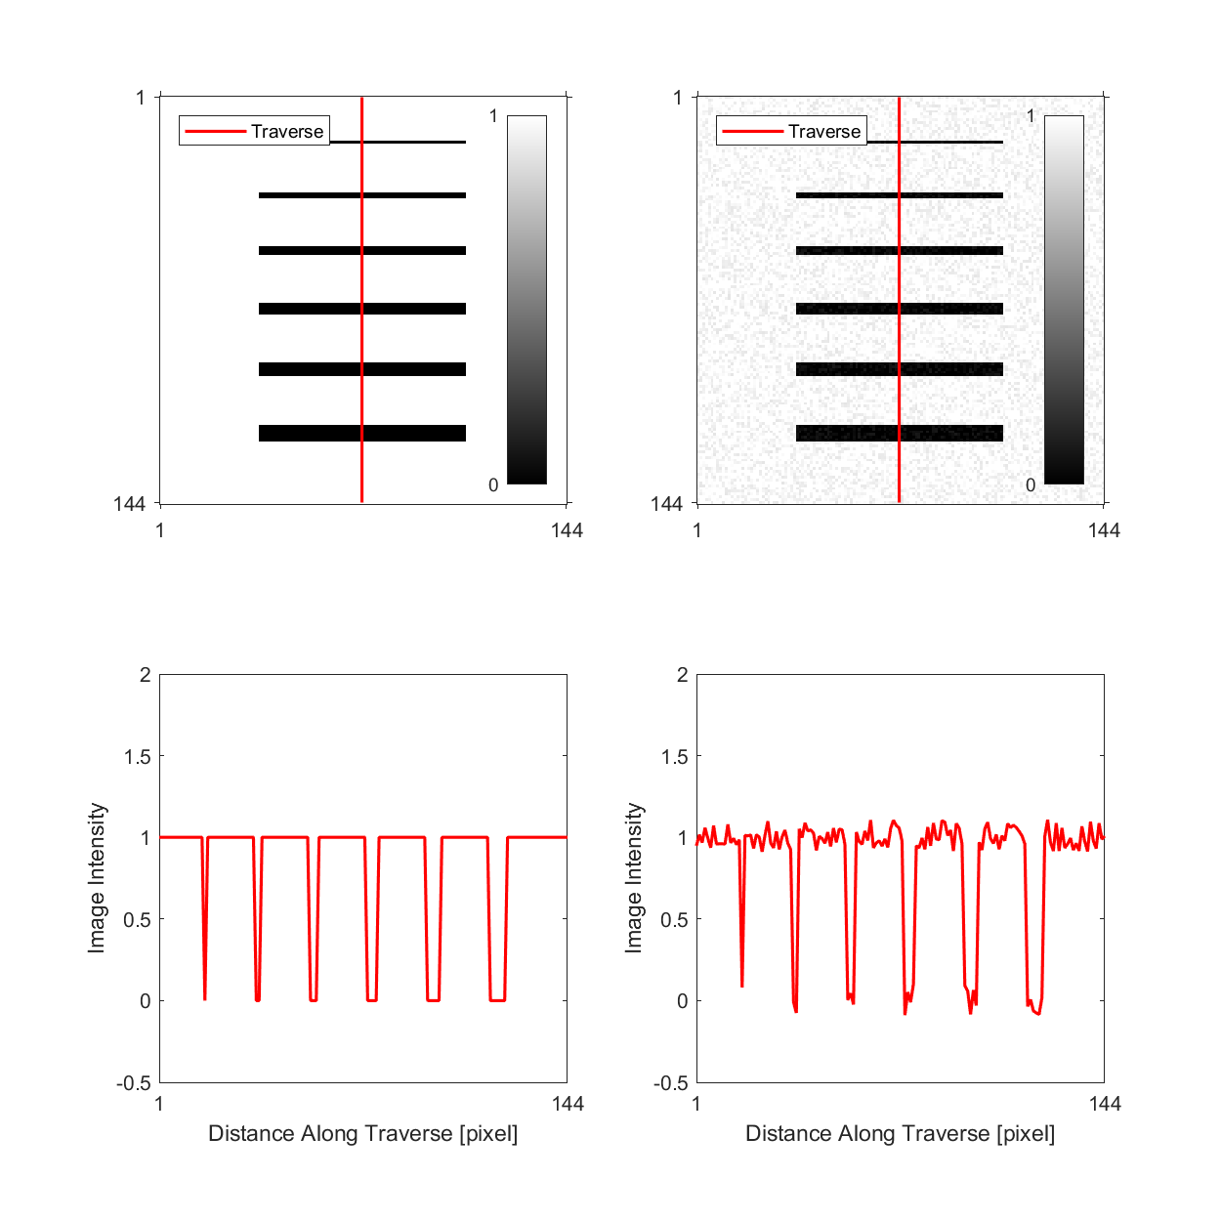

Methods: Generating Synthetic Fractures
Notes:
In order to understand how

Slide 13
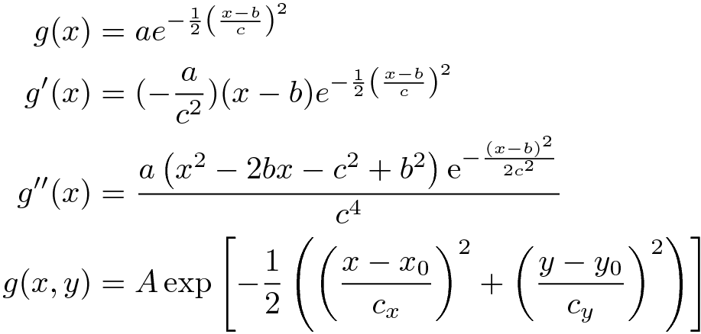
Methods: Fracture Detection (The Hessian Method)
Notes:
Using http://www.tlhiv.org/ltxpreview/
\begin{align*}
g(x) & = a e^{-\frac{1}{2} \left( \frac{x-b}{c}\right)^2} \\
g'(x) & = (-\frac{a}{c^2}) (x - b) e^{-\frac{1}{2} \left( \frac{x-b}{c}\right)^2} \\
g''(x) & = \frac{a\left(x^2-2bx-c^2+b^2\right)\mathrm{e}^{-\frac{\left(x-b\right)^2}{2c^2}}}{c^4} \\
g(x,y) & = A \exp \left[ -\frac{1}{2} \left( \left( \frac{x - x_0}{c_x} \right)^2 + \left( \frac{y - y_0}{c_y} \right)^2 \right) \right]
\end{align*}

Slide 14
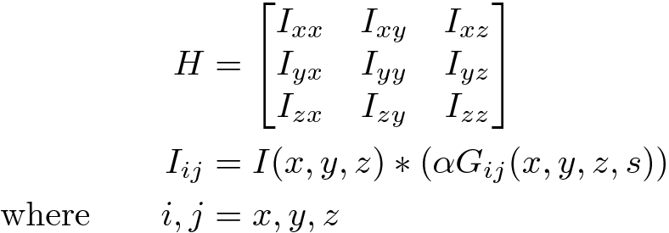
Methods: Computing The Hessian
Voorn et al. 2013
Notes:
Using http://www.tlhiv.org/ltxpreview/
\begin{align*}
g(x) & = a e^{-\frac{1}{2} \left( \frac{x-b}{c}\right)^2} \\
g'(x) & = (-\frac{a}{c^2}) (x - b) e^{-\frac{1}{2} \left( \frac{x-b}{c}\right)^2} \\
g''(x) & = \frac{a\left(x^2-2bx-c^2+b^2\right)\mathrm{e}^{-\frac{\left(x-b\right)^2}{2c^2}}}{c^4} \\
g(x,y) & = A \exp \left[ -\frac{1}{2} \left( \left( \frac{x - x_0}{c_x} \right)^2 + \left( \frac{y - y_0}{c_y} \right)^2 \right) \right]
\end{align*}

Slide 15
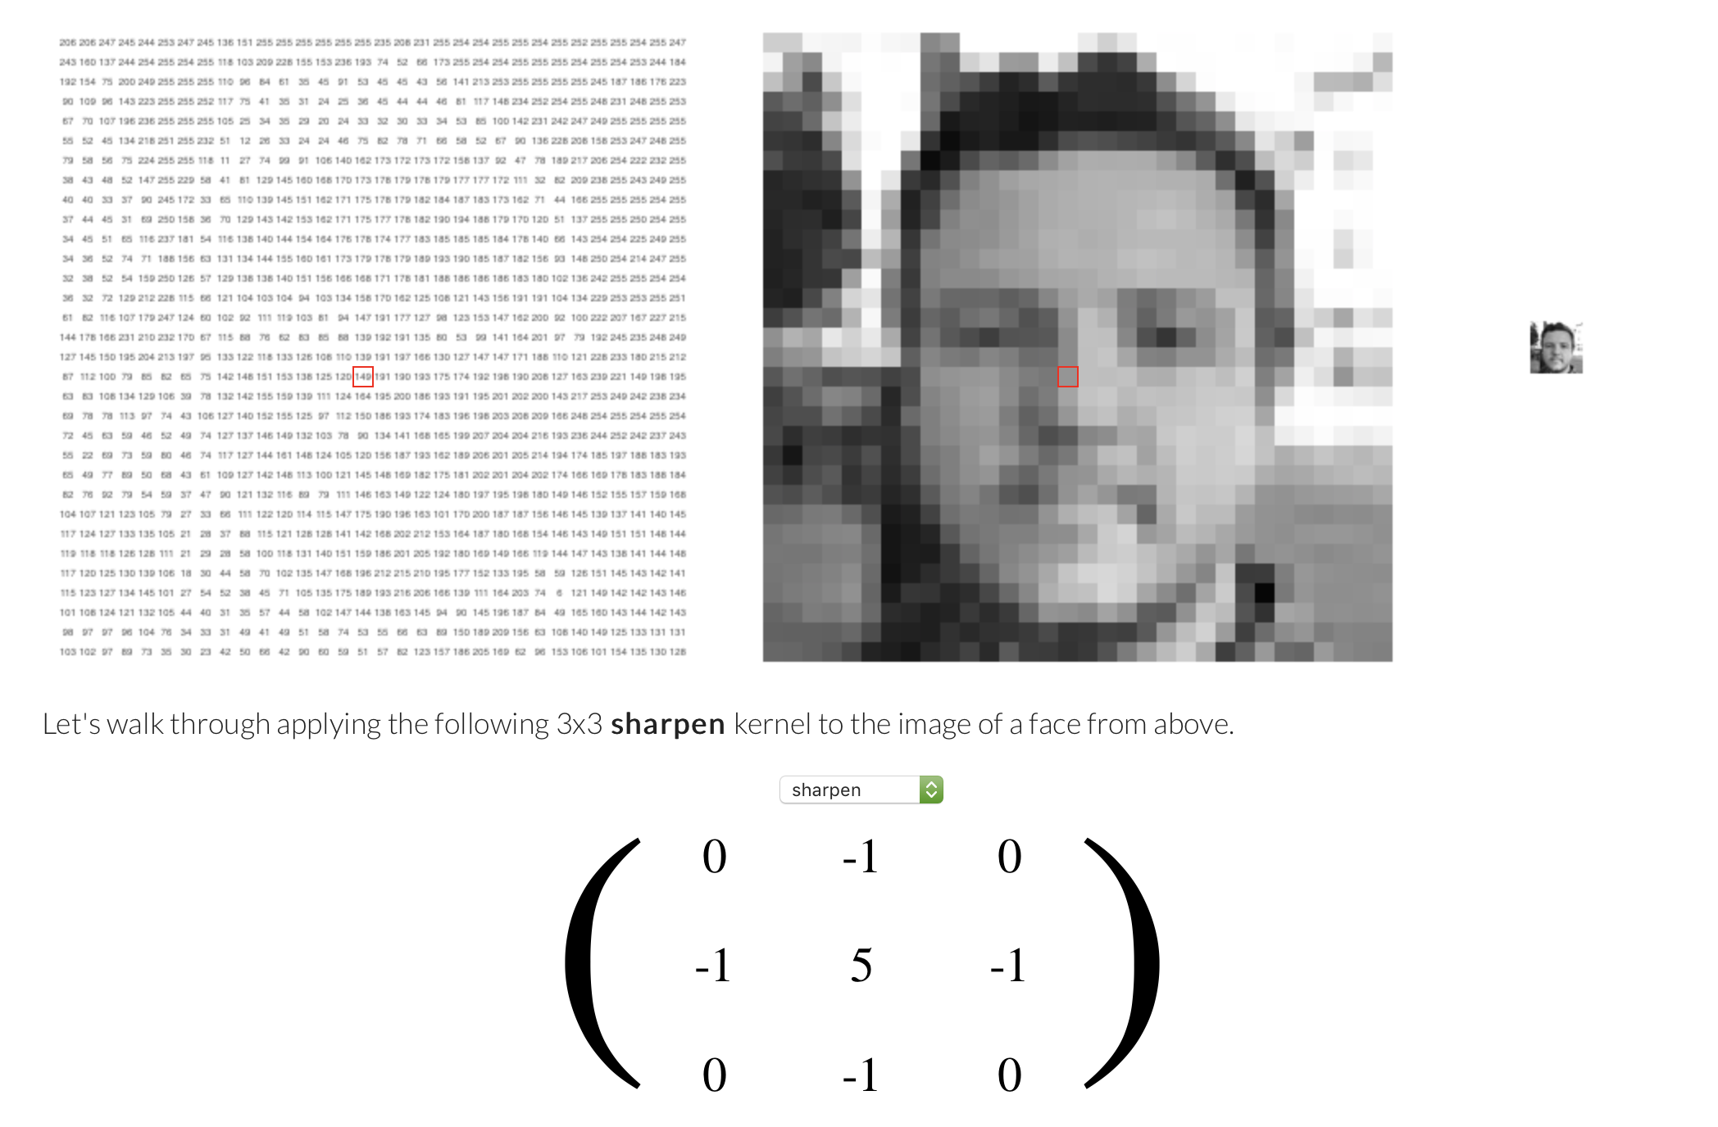
Methods: Computing The Hessian
Notes:
http://setosa.io/ev/image-kernels/

Slide 16
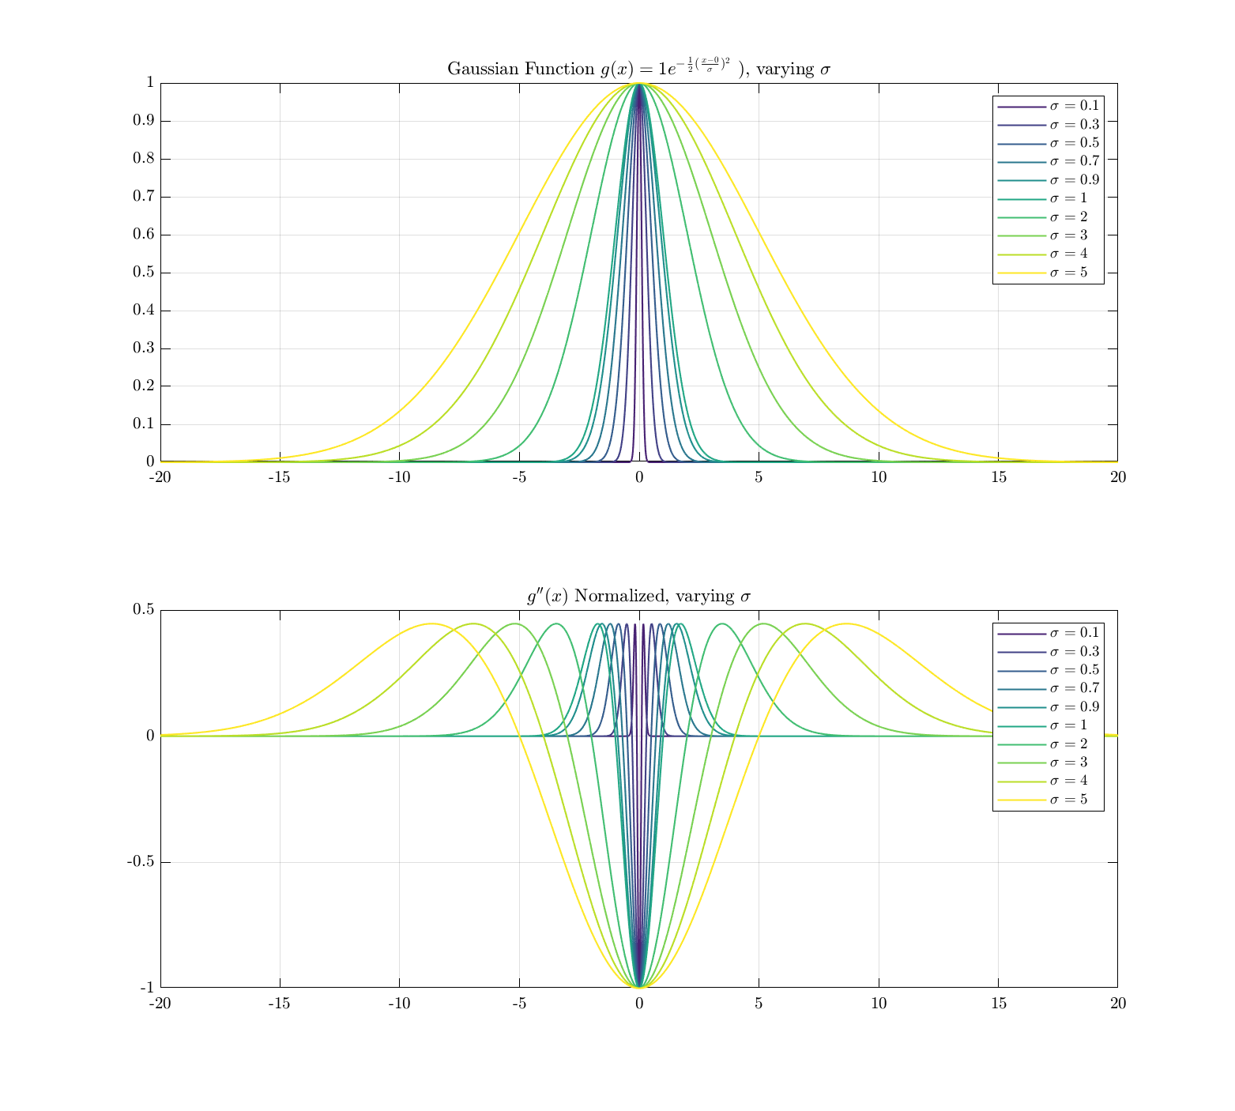
Methods: Continuous G_xx
c, s, σ
Notes:
Using http://www.tlhiv.org/ltxpreview/
\begin{align*}
g(x) & = a e^{-\frac{1}{2} \left( \frac{x-b}{c}\right)^2} \\
g'(x) & = (-\frac{a}{c^2}) (x - b) e^{-\frac{1}{2} \left( \frac{x-b}{c}\right)^2} \\
g''(x) & = \frac{a\left(x^2-2bx-c^2+b^2\right)\mathrm{e}^{-\frac{\left(x-b\right)^2}{2c^2}}}{c^4} \\
g(x,y) & = A \exp \left[ -\frac{1}{2} \left( \left( \frac{x - x_0}{c_x} \right)^2 + \left( \frac{y - y_0}{c_y} \right)^2 \right) \right]
\end{align*}

Slide 17
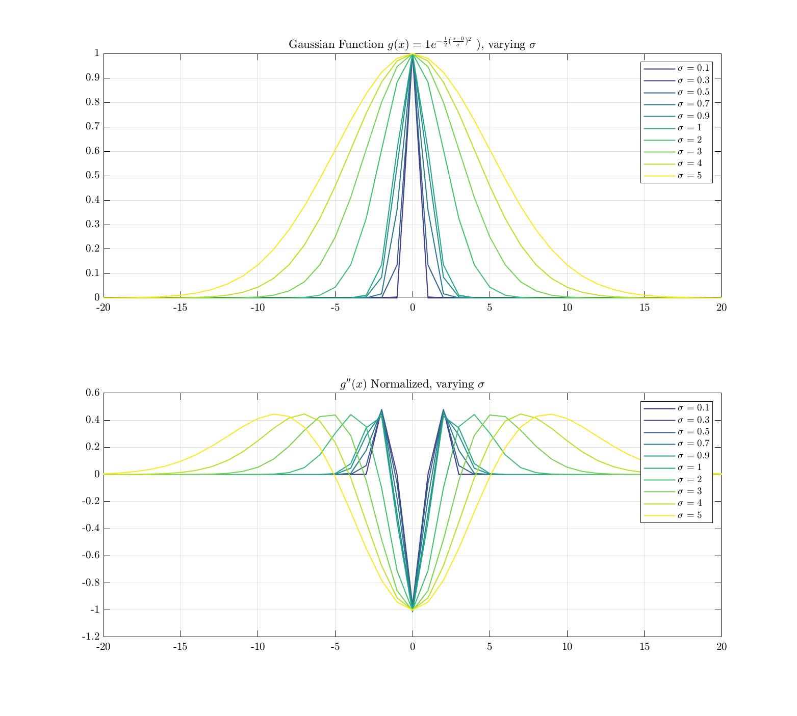
Methods: Discrete G_xx
Notes:
Using http://www.tlhiv.org/ltxpreview/
\begin{align*}
g(x) & = a e^{-\frac{1}{2} \left( \frac{x-b}{c}\right)^2} \\
g'(x) & = (-\frac{a}{c^2}) (x - b) e^{-\frac{1}{2} \left( \frac{x-b}{c}\right)^2} \\
g''(x) & = \frac{a\left(x^2-2bx-c^2+b^2\right)\mathrm{e}^{-\frac{\left(x-b\right)^2}{2c^2}}}{c^4} \\
g(x,y) & = A \exp \left[ -\frac{1}{2} \left( \left( \frac{x - x_0}{c_x} \right)^2 + \left( \frac{y - y_0}{c_y} \right)^2 \right) \right]
\end{align*}

Slide 18
Method: Images are discrete (and 3D)

Slide 19
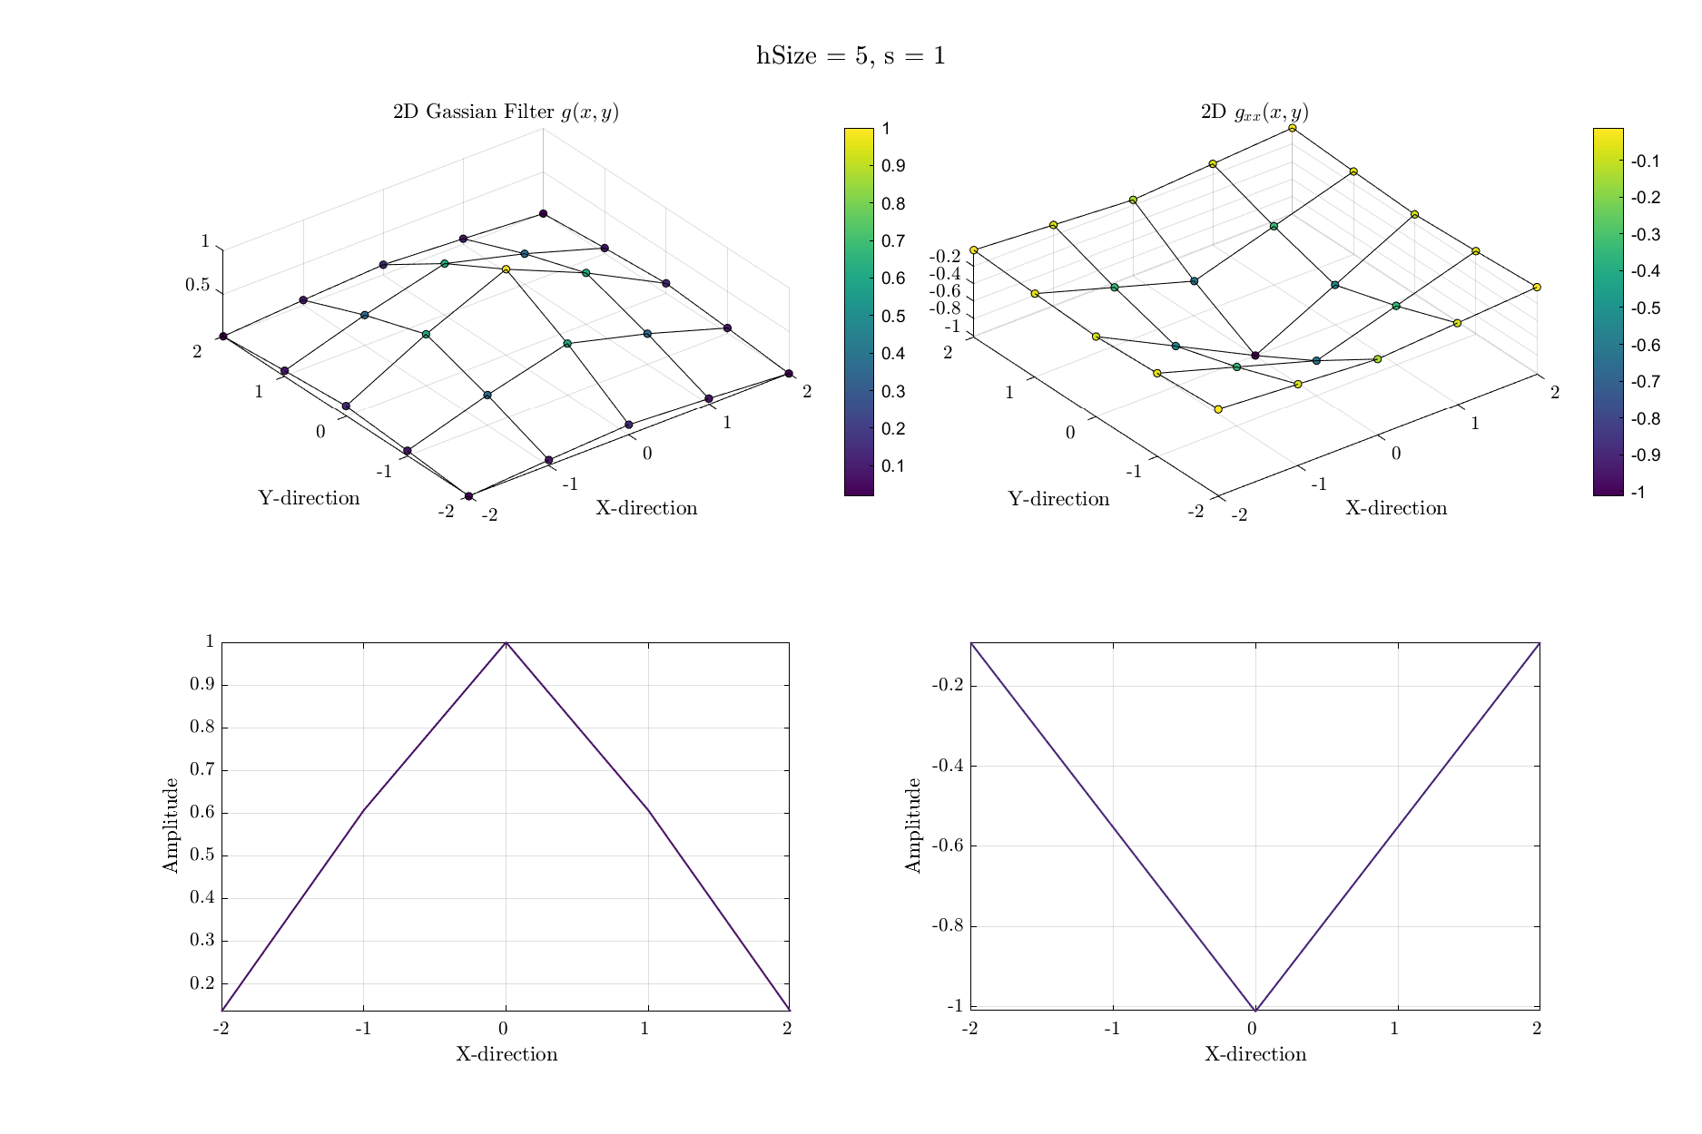
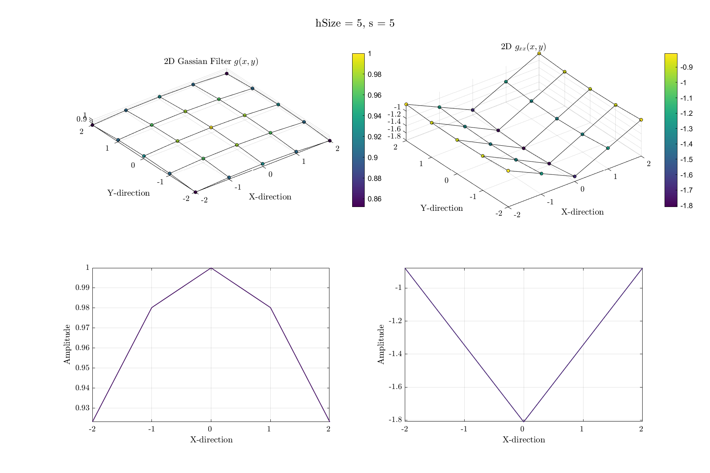
Methods: Discrete G_xx in 2D, shape is not appropriate
Notes:
Using http://www.tlhiv.org/ltxpreview/
\begin{align*}
g(x) & = a e^{-\frac{1}{2} \left( \frac{x-b}{c}\right)^2} \\
g'(x) & = (-\frac{a}{c^2}) (x - b) e^{-\frac{1}{2} \left( \frac{x-b}{c}\right)^2} \\
g''(x) & = \frac{a\left(x^2-2bx-c^2+b^2\right)\mathrm{e}^{-\frac{\left(x-b\right)^2}{2c^2}}}{c^4} \\
g(x,y) & = A \exp \left[ -\frac{1}{2} \left( \left( \frac{x - x_0}{c_x} \right)^2 + \left( \frac{y - y_0}{c_y} \right)^2 \right) \right]
\end{align*}

Slide 20
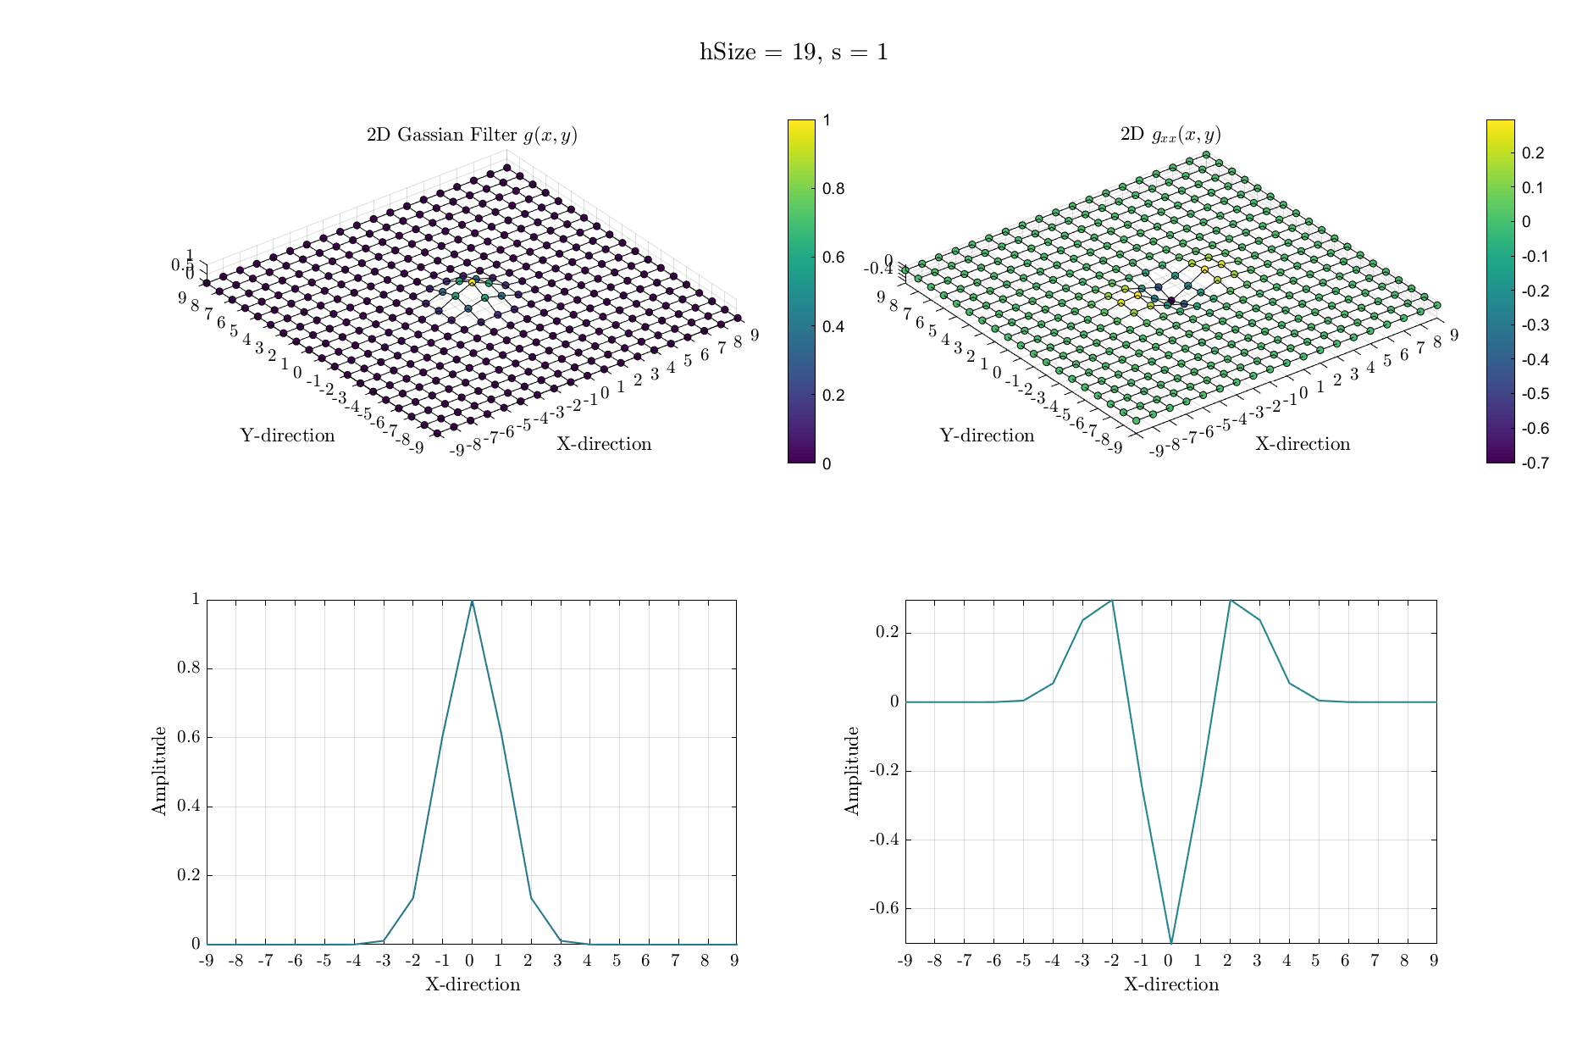
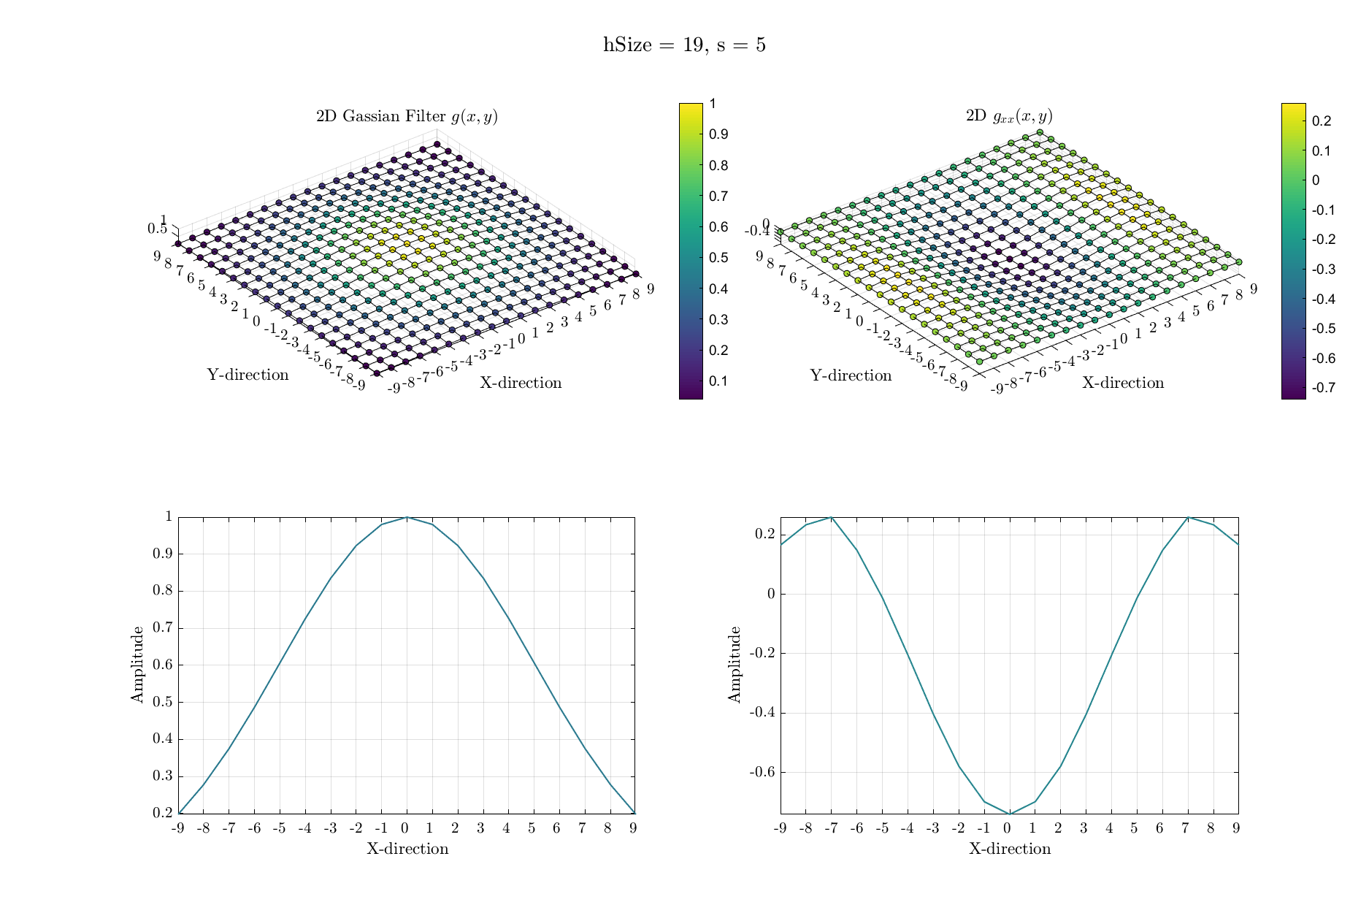
Methods: Discrete G_xx in 2D, shape looks good
Notes:
Using http://www.tlhiv.org/ltxpreview/
\begin{align*}
g(x) & = a e^{-\frac{1}{2} \left( \frac{x-b}{c}\right)^2} \\
g'(x) & = (-\frac{a}{c^2}) (x - b) e^{-\frac{1}{2} \left( \frac{x-b}{c}\right)^2} \\
g''(x) & = \frac{a\left(x^2-2bx-c^2+b^2\right)\mathrm{e}^{-\frac{\left(x-b\right)^2}{2c^2}}}{c^4} \\
g(x,y) & = A \exp \left[ -\frac{1}{2} \left( \left( \frac{x - x_0}{c_x} \right)^2 + \left( \frac{y - y_0}{c_y} \right)^2 \right) \right]
\end{align*}

Slide 21
Methods: Computing the Hessian
Notes:
Using http://www.tlhiv.org/ltxpreview/
\begin{align*}
g(x) & = a e^{-\frac{1}{2} \left( \frac{x-b}{c}\right)^2} \\
g'(x) & = (-\frac{a}{c^2}) (x - b) e^{-\frac{1}{2} \left( \frac{x-b}{c}\right)^2} \\
g''(x) & = \frac{a\left(x^2-2bx-c^2+b^2\right)\mathrm{e}^{-\frac{\left(x-b\right)^2}{2c^2}}}{c^4} \\
g(x,y) & = A \exp \left[ -\frac{1}{2} \left( \left( \frac{x - x_0}{c_x} \right)^2 + \left( \frac{y - y_0}{c_y} \right)^2 \right) \right]
\end{align*}

Slide 22
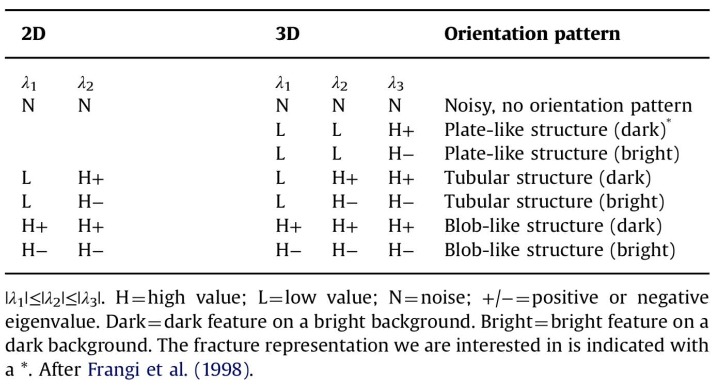
Methods: How is this useful?
Voorn et al. 2013
Notes:
Identifying plate like element, and eliminating blobs.

Slide 23
Methods: Computing the “Hessian”
Algorithm
For each s (scaling factor ~ ½ aperture of interest) in our case [1,2,3,4,6]
Compute all Hessian elements by convolution for each s
Loop over all voxels and compute the eigenvalues and eigenvectors
Sort the eigenvalues (from smallest to largest)
For each voxel compute A_s = ƛ_3 - |ƛ_2| - |ƛ_1|
Compute B_s = A_s if A_s > 0, or 0 otherwise
Normalize B_s such that 0< B_s < 1
Determine C_s such that C_s = 1 if A_x > 1 - tol, or 0 otherwise
The sum up all of C_s for each s value
Notes:
Using http://www.tlhiv.org/ltxpreview/
\begin{align*}
g(x) & = a e^{-\frac{1}{2} \left( \frac{x-b}{c}\right)^2} \\
g'(x) & = (-\frac{a}{c^2}) (x - b) e^{-\frac{1}{2} \left( \frac{x-b}{c}\right)^2} \\
g''(x) & = \frac{a\left(x^2-2bx-c^2+b^2\right)\mathrm{e}^{-\frac{\left(x-b\right)^2}{2c^2}}}{c^4} \\
g(x,y) & = A \exp \left[ -\frac{1}{2} \left( \left( \frac{x - x_0}{c_x} \right)^2 + \left( \frac{y - y_0}{c_y} \right)^2 \right) \right]
\end{align*}

Slide 24
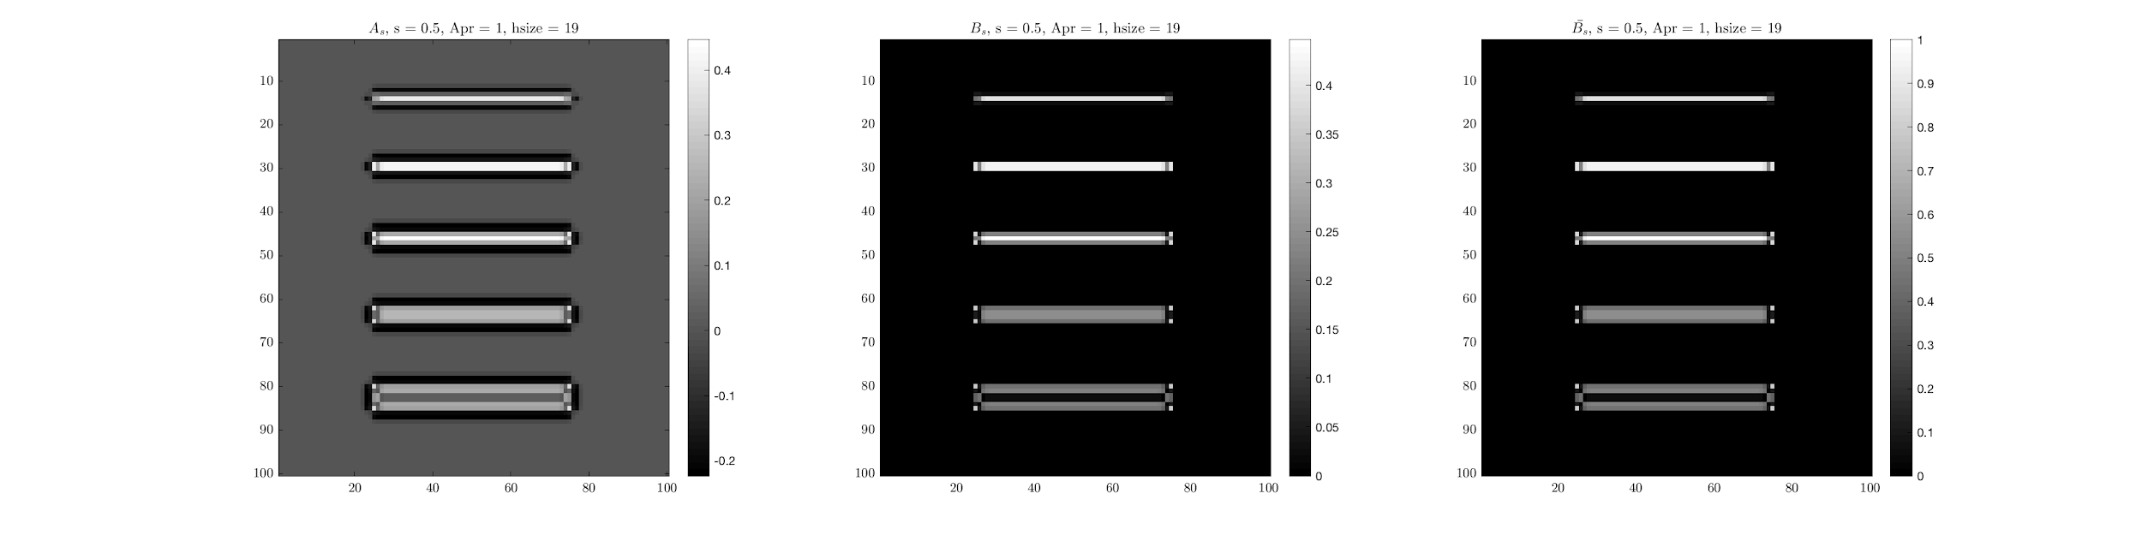
Method: the values for A_s, B_s, and Normalized B_s

Slide 25
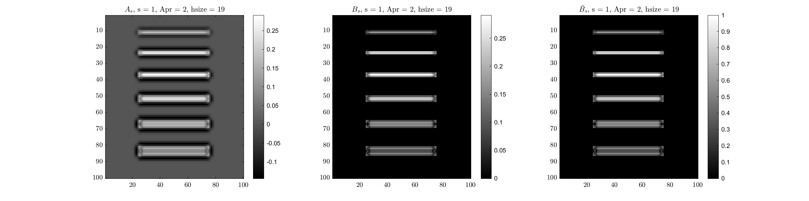
Method: the values for A_s, B_s, and Normalized B_s

Slide 26
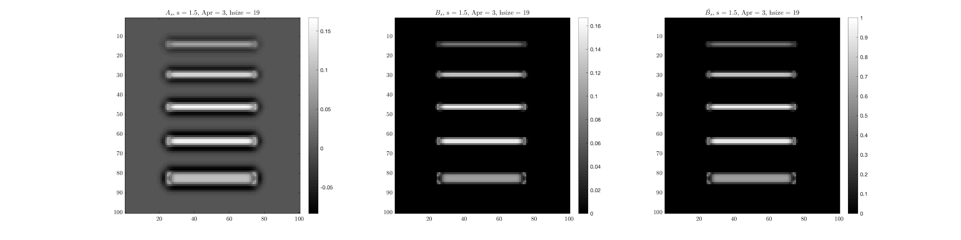
Method: the values for A_s, B_s, and Normalized B_s

Slide 27
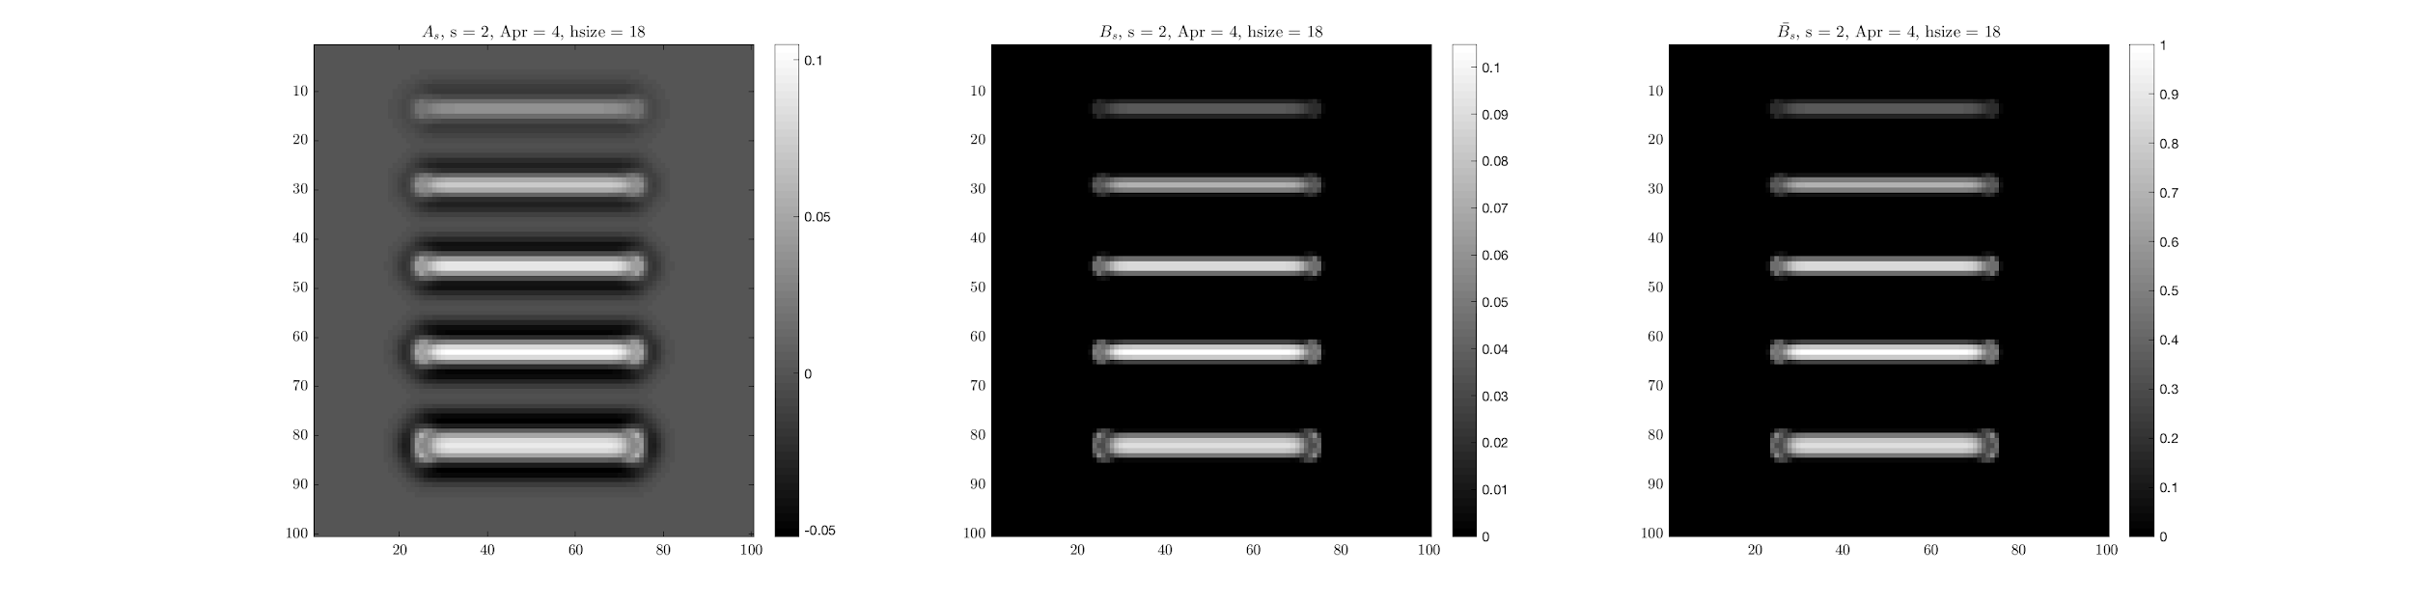
Method: the values for A_s, B_s, and Normalized B_s

Slide 28
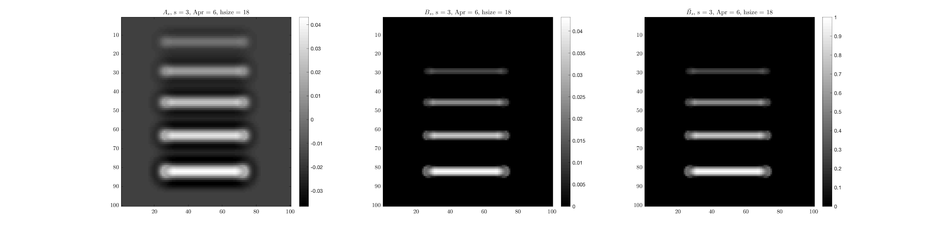
Method: the values for A_s, B_s, and Normalized B_s

Slide 29
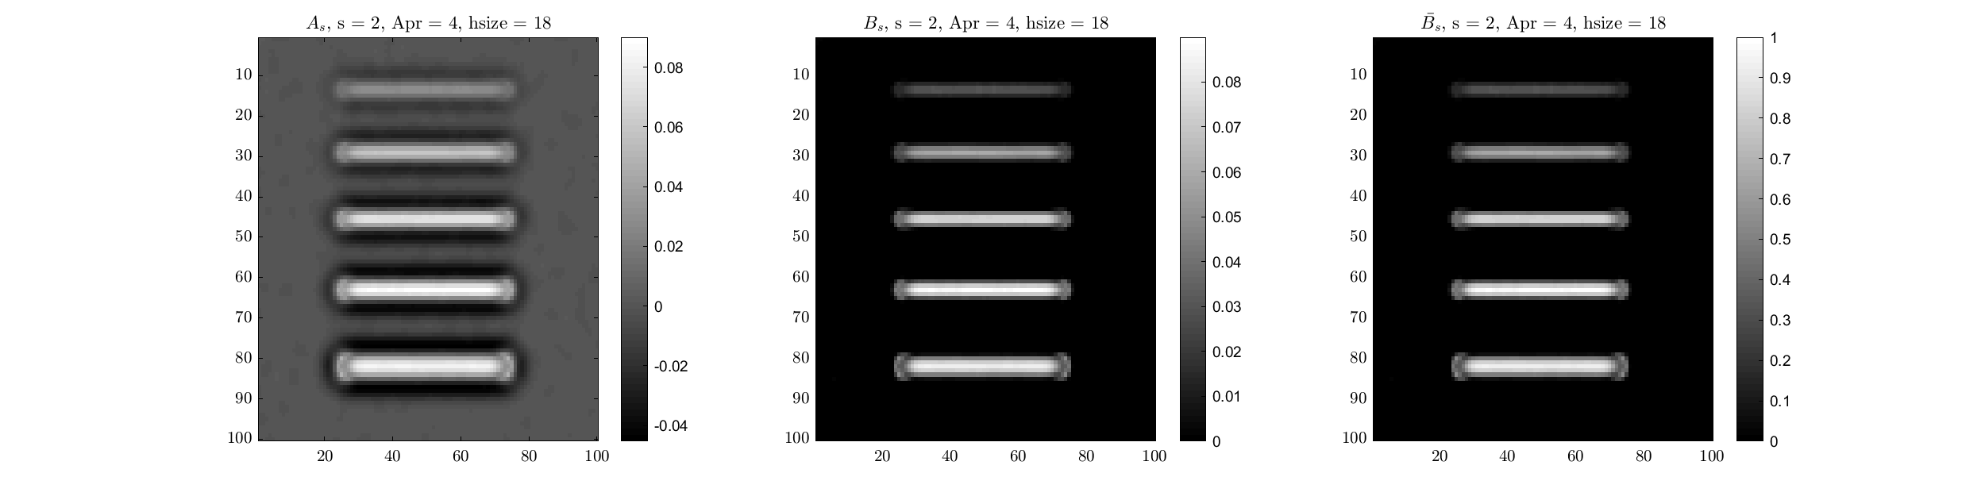
Method: the values for A_s, B_s, and Normalized B_s
Crisp image
Blurry and noisy image

Slide 30
Methods: Computing the “Hessian”
Algorithm
For each s (scaling factor ~ ½ aperture of interest) in our case [1,2,3,4,6]
Compute all Hessian elements by convolution for each s
Loop over all voxels and compute the eigenvalues and eigenvectors
Sort the eigenvalues (from smallest to largest)
For each voxel compute A_s = ƛ_3 - |ƛ_2| - |ƛ_1|
Compute B_s = A_s if A_s > 0, or 0 otherwise
Normalize B_s such that 0< B_s < 1
Determine C_s such that C_s = 1 if A_x > 1 - tol, or 0 otherwise
The sum up all of C_s for each s value
Notes:
Using http://www.tlhiv.org/ltxpreview/
\begin{align*}
g(x) & = a e^{-\frac{1}{2} \left( \frac{x-b}{c}\right)^2} \\
g'(x) & = (-\frac{a}{c^2}) (x - b) e^{-\frac{1}{2} \left( \frac{x-b}{c}\right)^2} \\
g''(x) & = \frac{a\left(x^2-2bx-c^2+b^2\right)\mathrm{e}^{-\frac{\left(x-b\right)^2}{2c^2}}}{c^4} \\
g(x,y) & = A \exp \left[ -\frac{1}{2} \left( \left( \frac{x - x_0}{c_x} \right)^2 + \left( \frac{y - y_0}{c_y} \right)^2 \right) \right]
\end{align*}

Slide 31
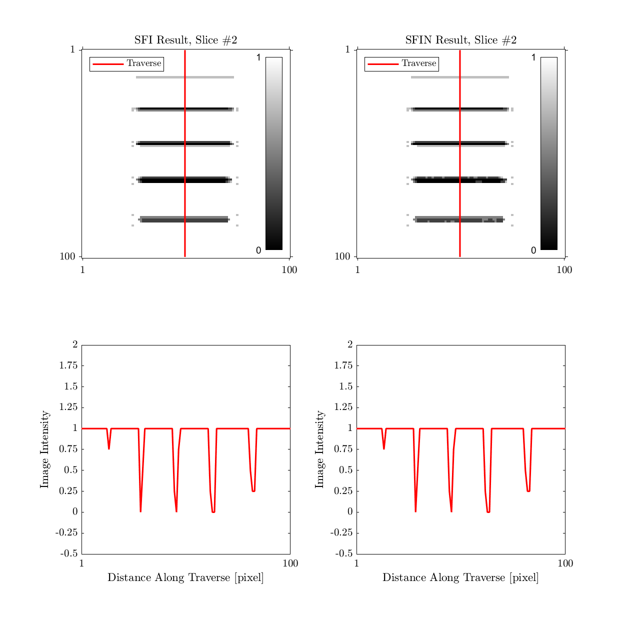
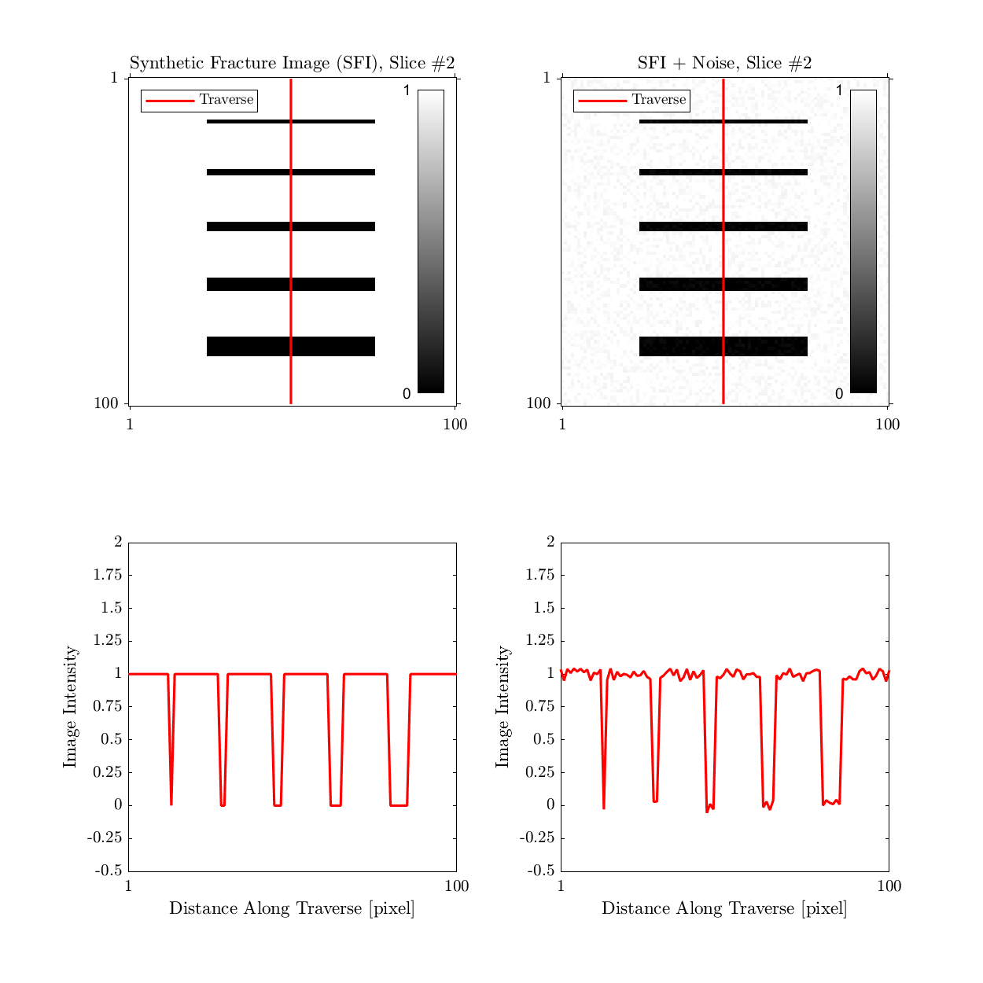
Methods: Hessian Result (crisp images)

Slide 32
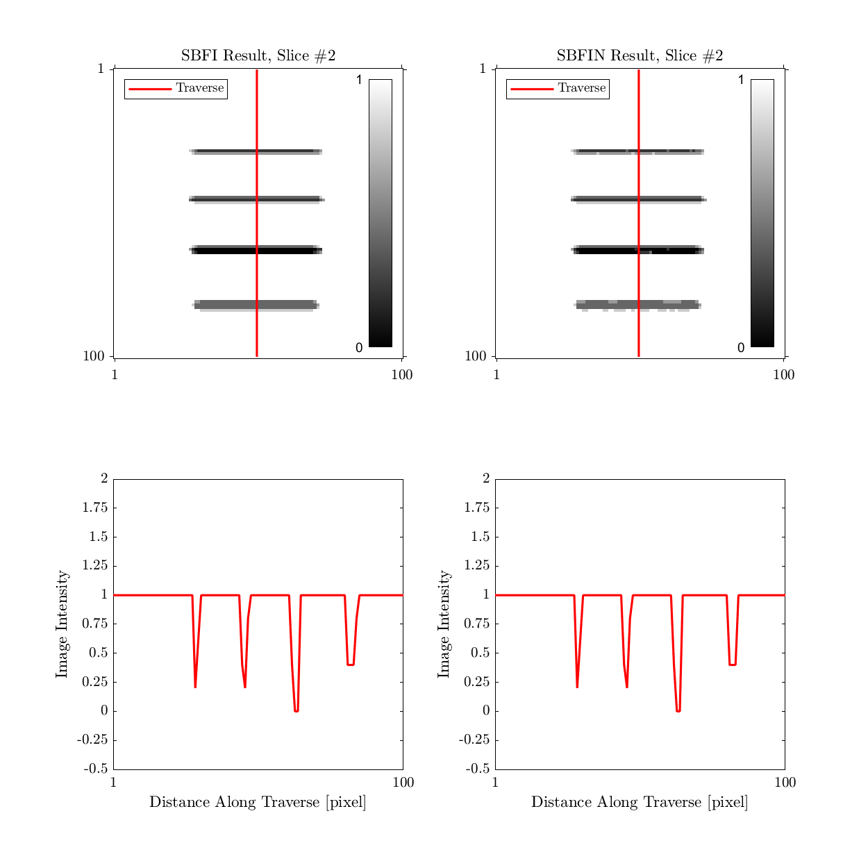
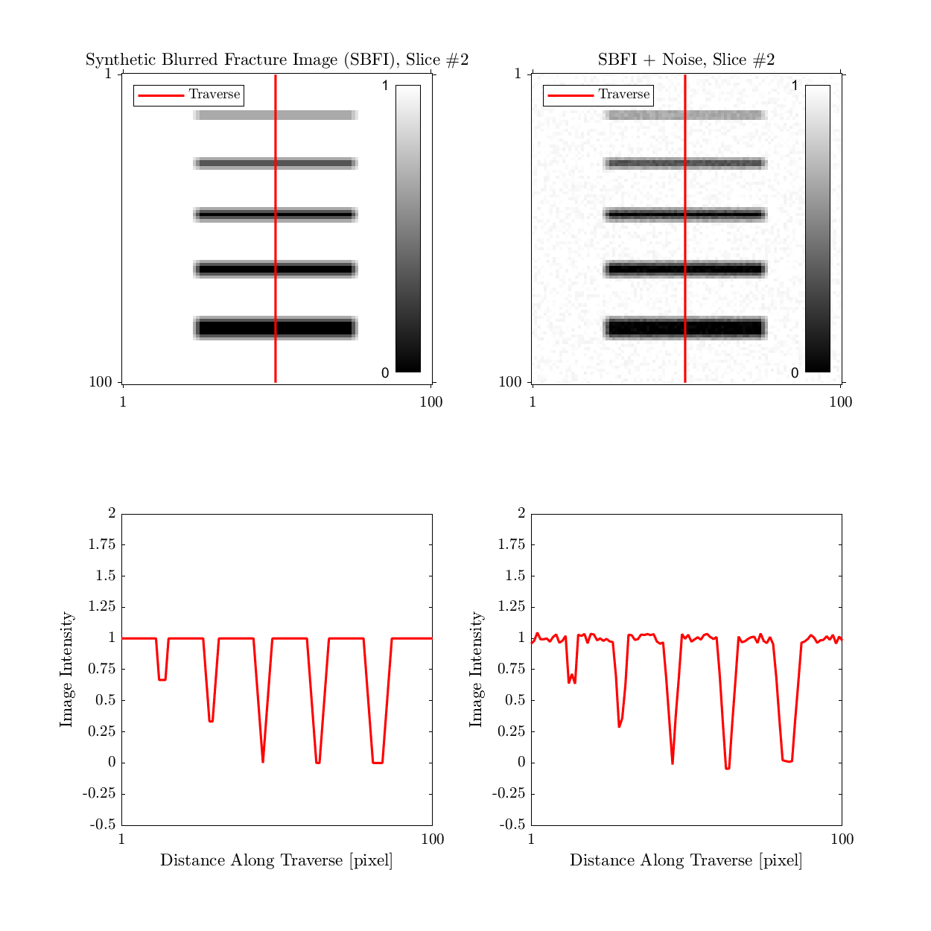
Methods: Hessian Result (blurry images)

Slide 33
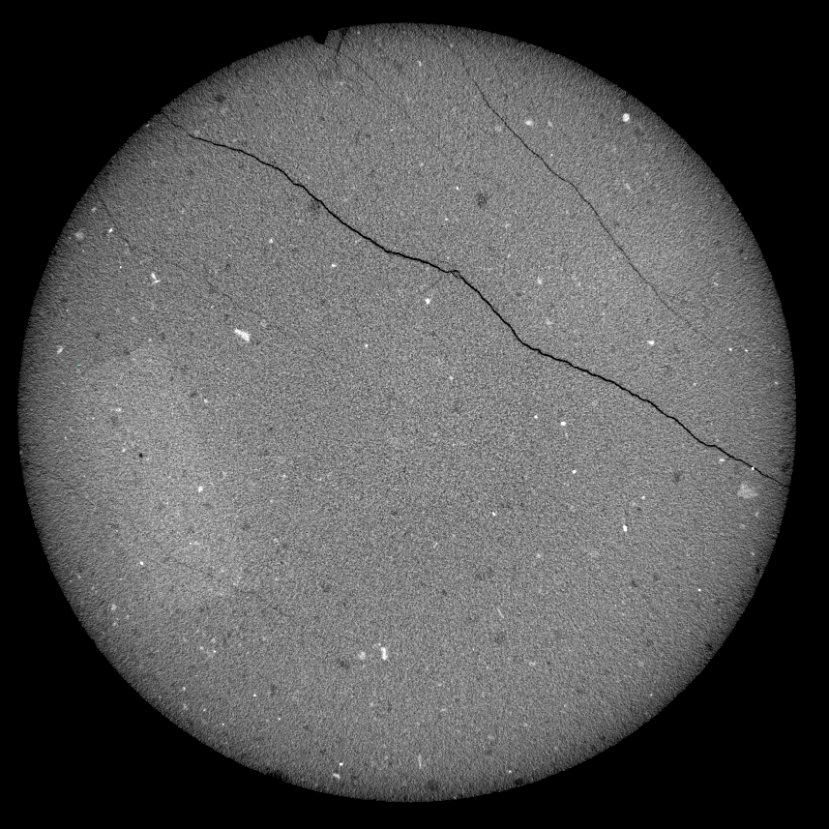
Materials
Argillite mudrock
Core hand-drilled from creekbed

Slide 34
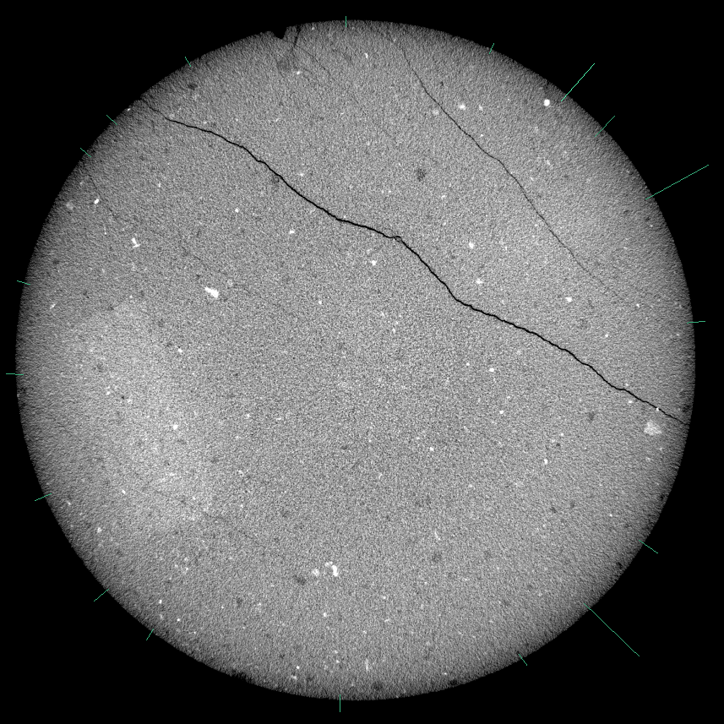
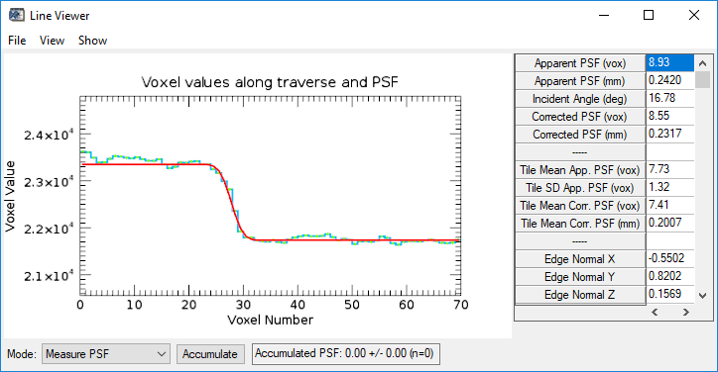
Point Spread Function in Blob3D

Slide 35
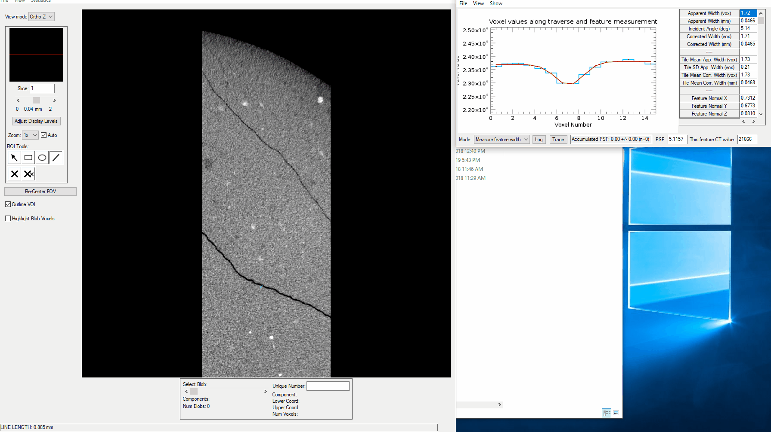
No segmentation: Blob3D

Slide 36
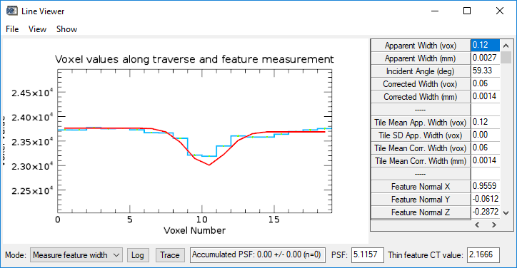
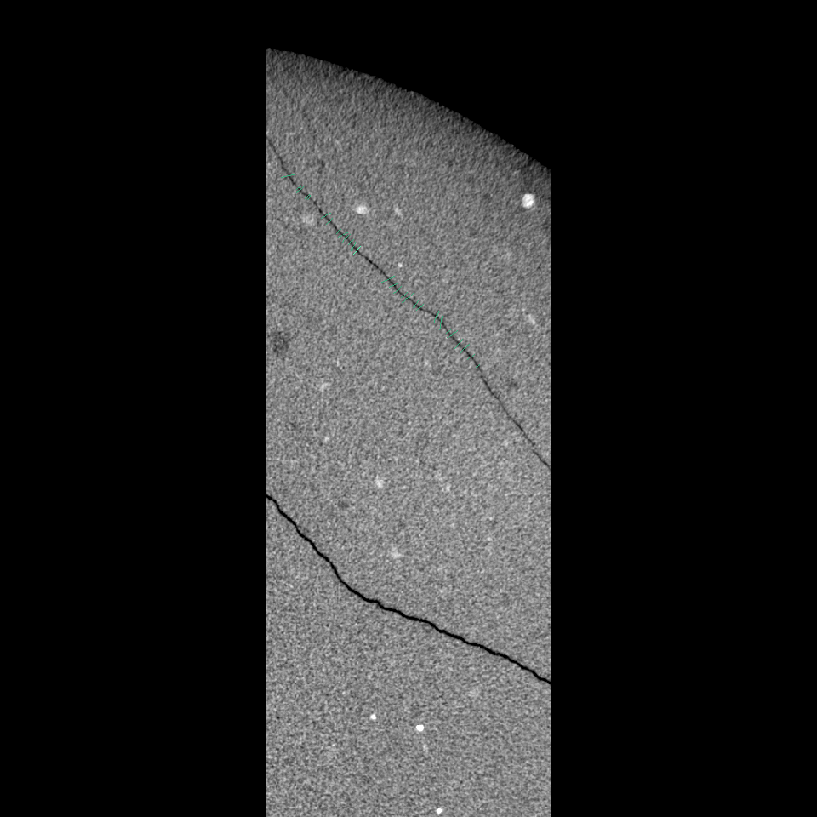
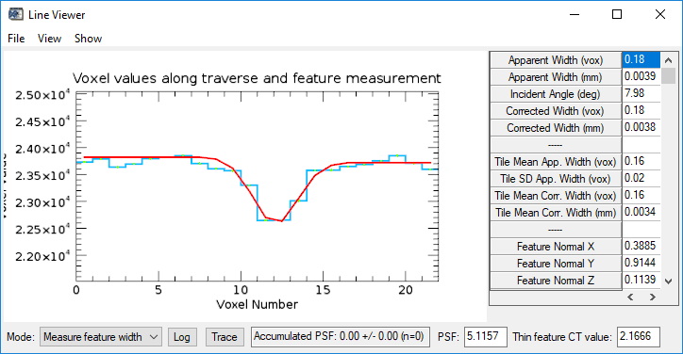
No segmentation: Blob3D

Slide 37
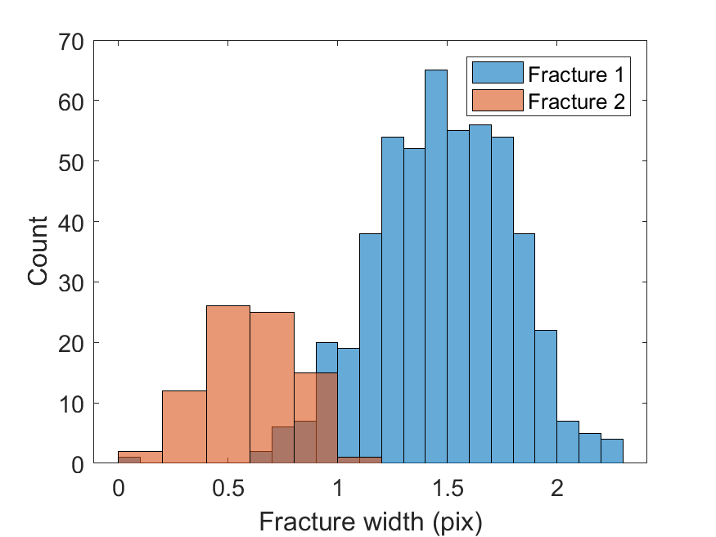
No segmentation: Blob3D
Fracture 1 mean: 1.5+-0.3
Fracture 2 mean: 0.6+-0.2

Slide 38


Trainable segmentation: Blob3D

Slide 39

Trainable segmentation: Blob3D
Fracture 1 mean: 6.5+-0.8
Fracture 2 mean: 4.5+-1.0

Slide 40



Trainable segmentation: Distance function

Slide 41



Hessian segmentation: distance function

Slide 42

Hessian segmentation: distance function
Fracture 1 mean: 0.8+-0.4
Fracture 2 mean: 0.3+-0.1

Slide 43



Hessian segmentation: distance function

